Slide 1

Research Progress Record
Enmao Diao
Jan 29 2022

Slide 2
Overview
Gradient Assisted Learning
Semi-Supervised Federated Learning
Compressing Turbulence
Assisted Recommendation System
Federated Distillation
Gradient Decentralized Neural Network
Finite Neural Networks
Others

Slide 3
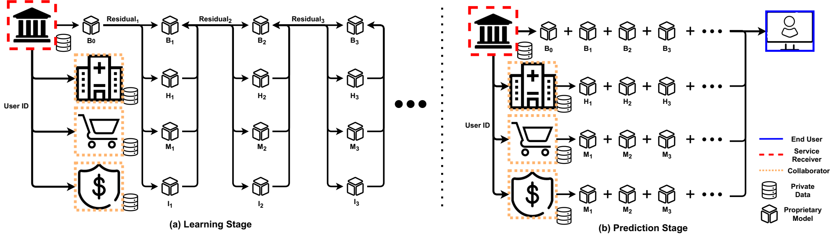
Gradient Assisted Learning
Submitted to ICML 2022
We propose Gradient Assisted Learning (GAL), a new method for various entities to assist each other in supervised learning tasks without sharing data, models, and objective functions.

Slide 4
Gradient Assisted Learning
VAFL experimental results (Abandoned)
Experiments mixing models to show model autonomous (UCI)
Deep model generalization (MNIST, CIFAR10)
Case study (Multi-view 3d Object Recognition (ModelNet40, ShapNet55), Hospital Division(MIMICL, MIMICM
Experiments on Privacy
Further theoretical Analysis (move to main paper)

Slide 5
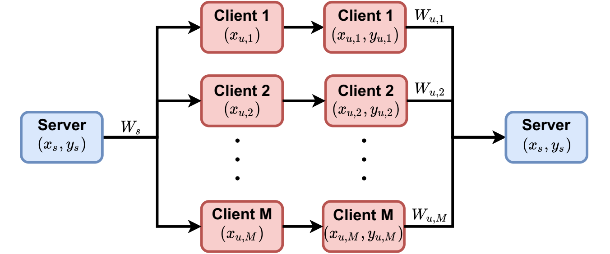
Semi-Supervised Federated Learning
Submitted to ICML 2022
We propose a new Federated Learning framework referred to as SemiFL in order to address the problem of Semi-Supervised Federated Learning (SSFL).

Slide 6
Semi-Supervised Federated Learning
Experiments for unifying models and experimental setup for baselines
Labeled data on client (later for journal)
Case study (later for journal)
Further theoretical Analysis (Abandoned)

Slide 7
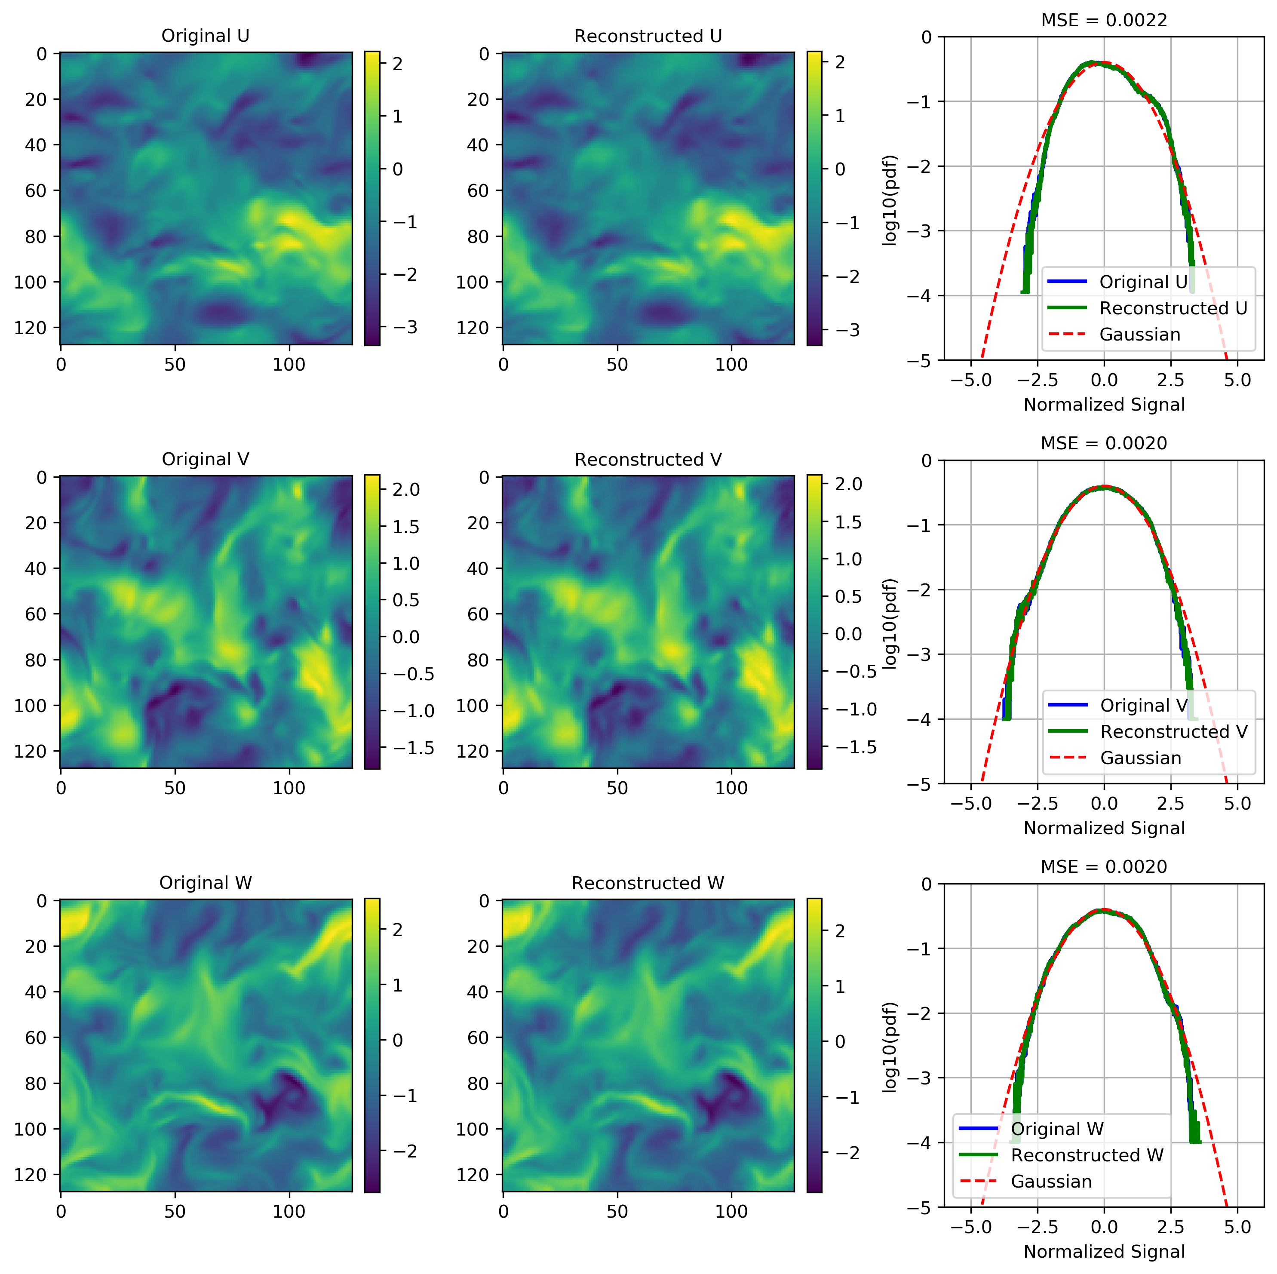
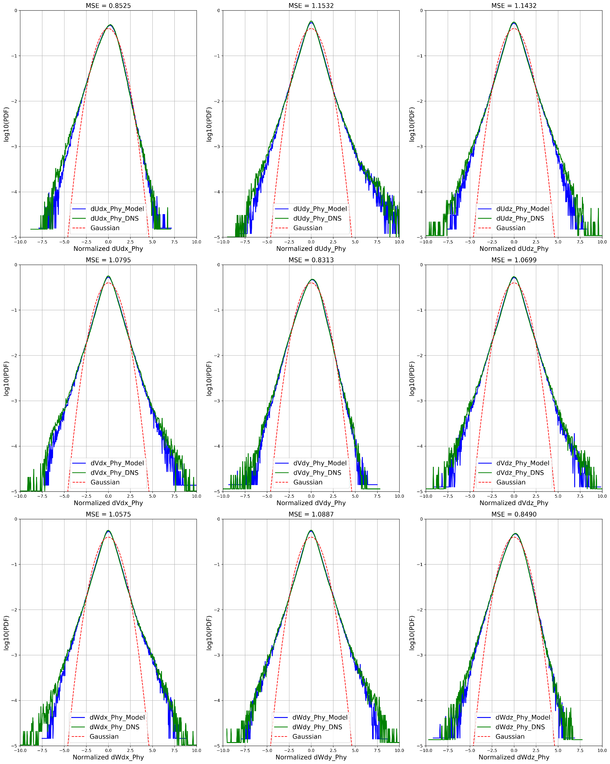
Compressing Turbulence
Under review by Journal of Turbulence
Submittted a conference or workshop paper
DCC 2022 (accepted main paper)
AAAI-MLPS2 2022 (accepted poster)

Slide 8
Assisted recommendation system
Multiple organization collaboratively learn a recommendation system
User/Item align
Explicit/Implicit feedback
AutoEncoder
Use gradient assisted learning to train vertical-split recommendation data

Slide 9
Assisted recommendation system
Experiments with Amazon Reviews
Experiments on privacy
Prepared for KDD 2022

Slide 10
Knowledge Distillation
Data-Free Ensemble Distillation (DFED)
Data-Free Federated distillation for Non-IID data
Data efficiency of KD and Sparsity Index
Theoretical work
Prepare for CVPR 2022, NeurIPS 2022

Slide 11
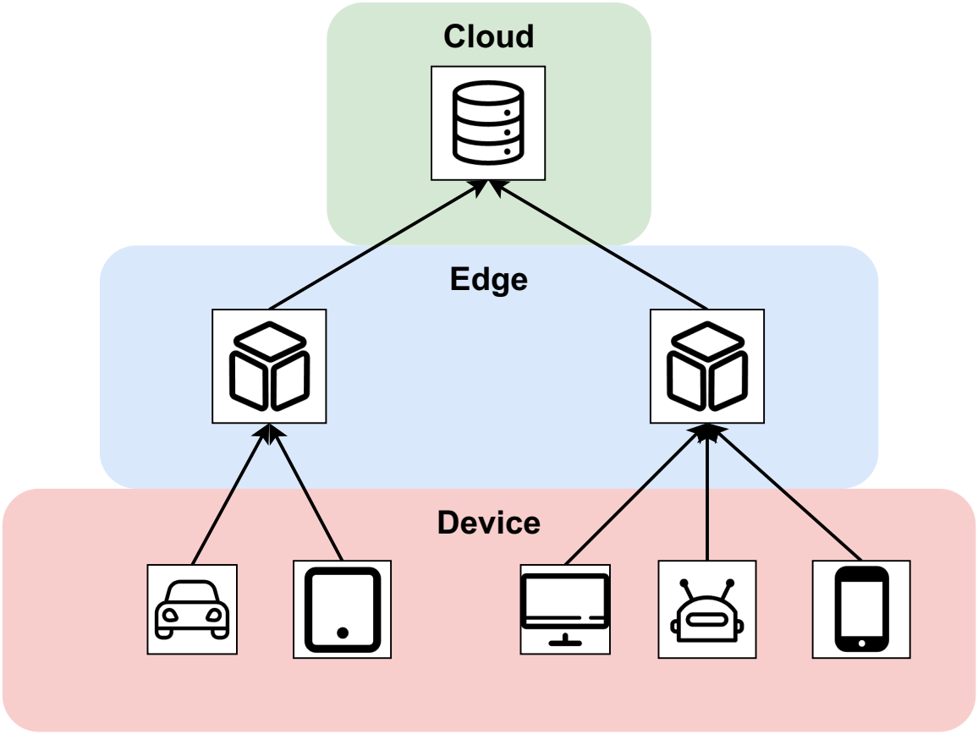
Gradient Decentralized Neural Network
Boosting on Edge
End, Edge, Cloud each hosts a model to train the residual passing from lower level. End device is the lowest and has all the data. The features and residuals are transmitted to next level
Multiple iteration of boosting may also work
Prepare for ICML2022

Slide 12
Finite Neural Networks
Input, weights and output are all on finite field
I find formal derivatives can be defined for finite field with product rule of calculus
In mathematics, the formal derivative is an operation on elements of a polynomial ring or a ring of formal power series that mimics the form of the derivative from calculus.
https://en.wikipedia.org/wiki/Formal_derivative
For example d(X^5)/dx = 5X^4 which means summation of X^4 5 times. d(f(X)/5)/dx = 1/5 d(f(X))/dx in finite field means find a value that when add 5 times equal d(f(X))/dx.
I think it is feasible to implement Finite Neural Networks with these definition.

Slide 13
Others
Generalized Assisted Learning
Noisy Alignment
Organization Selection
Federated recommendation system
Autoencoder
Separate encoder, but upload decoder for federated learning (horizontal and vertical)
Prepare for RecSys 2022
Federated Unsupervised Domain Adaptation for Target Clients
Target (unlabeled data) at clients, and Source (labeled data) at server

Slide 14
Others
Assisted Supply Chain Forecasting
Match with timestamp and geographical location (universal ID) for supply chain forecasting
Fairness
Fairness with Federated Learning and Assisted Learning
Deep Hypothesis Test
Fisher Score for hypothesis test

Slide 15
Others
Boosting GAN
Inspired by Progressive GAN
Each scale is a network and the next network is trained from pseudo-residual
Transformer
WNet
Use Wavelet to replace Fourier Transform in FNet
For time series prediction, classification problem
AETA earthquake competition
Computer Audio processing
Train the kernel inside wavelet to replace convolution layer to reduce computation and kernel size
Possible extend to other integral transform
Apply for compression and classification

Slide 16
Others
Deep Channel Coding
Frequency domain or wavelet-based channel coding with Fourier operator
Defend adversarial attacks from intermediate layers
Hypothesis: Even though we only change very little to the input image and easily attack trained neural network. Intermediate layer features should have a very different distribution from the trained dataset. The change of result cannot happen within one layer. It is the deep nature makes classifier fragile
Design a simple Defensive BatchNorm to check statistics for adversarial detection
Recent works use MMD as data to learn detect adversarial attack

Slide 17
Others
Predictive gradient descent, meta-learning
Forget about learning rate. Theoretically there always exists a best gradient step at each iteration. We use learning history as our training data and predict the best gradient step. Deep Learning for optimization
Lifelong Learning
Lifelong federated generative model
Lifelong learning with recalibration of BN

